Slide 1
Smith Analytics Consortium
NBA Analytics Team: Devs

Slide 2
Agenda
Meet the team
Datasets and Data Wrangling
Finalize Cities
Cost and Revenue Analysis
Sponsorship Analysis
Team Name and Mascot
International expansion
Tech to support expansion

Slide 3
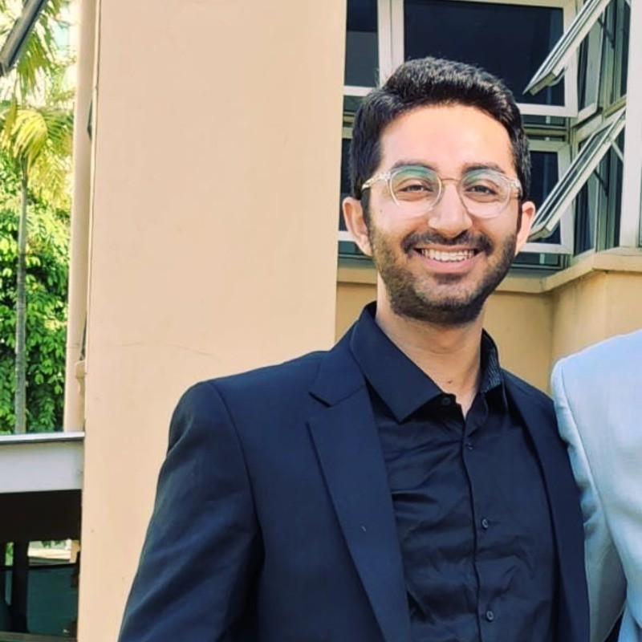
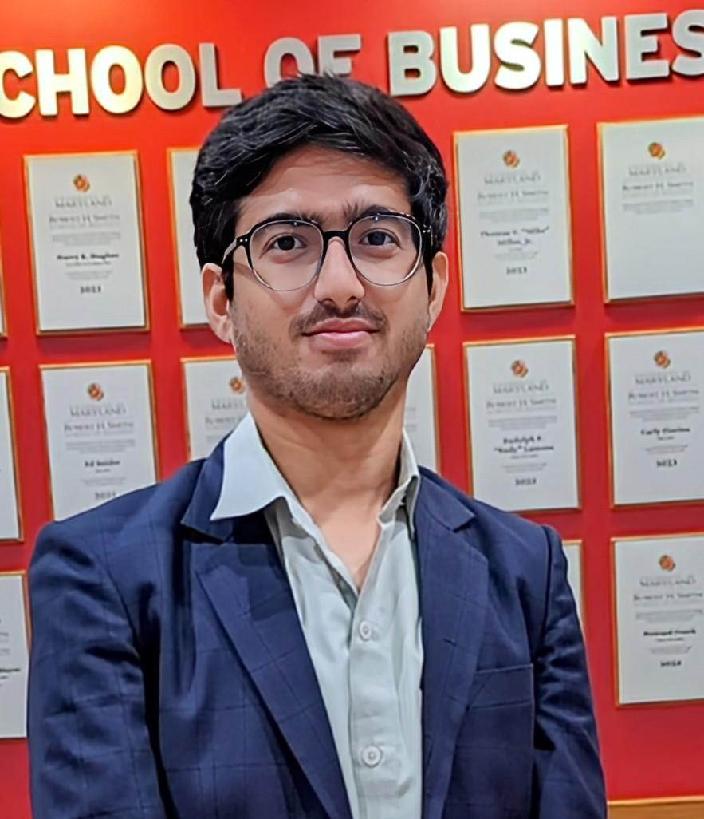

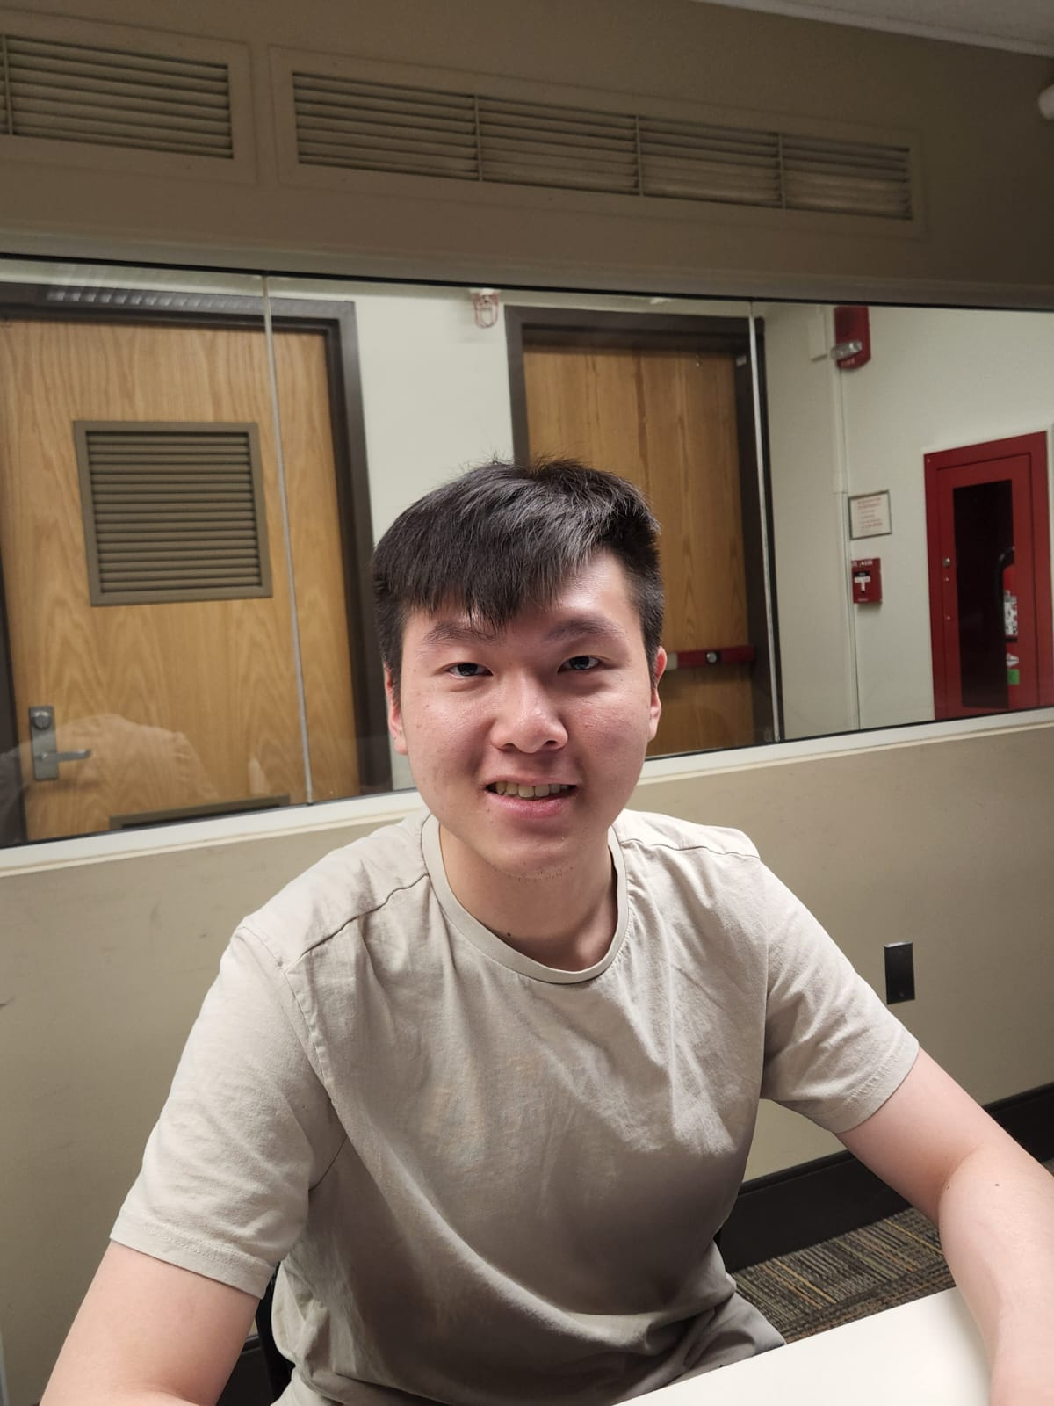

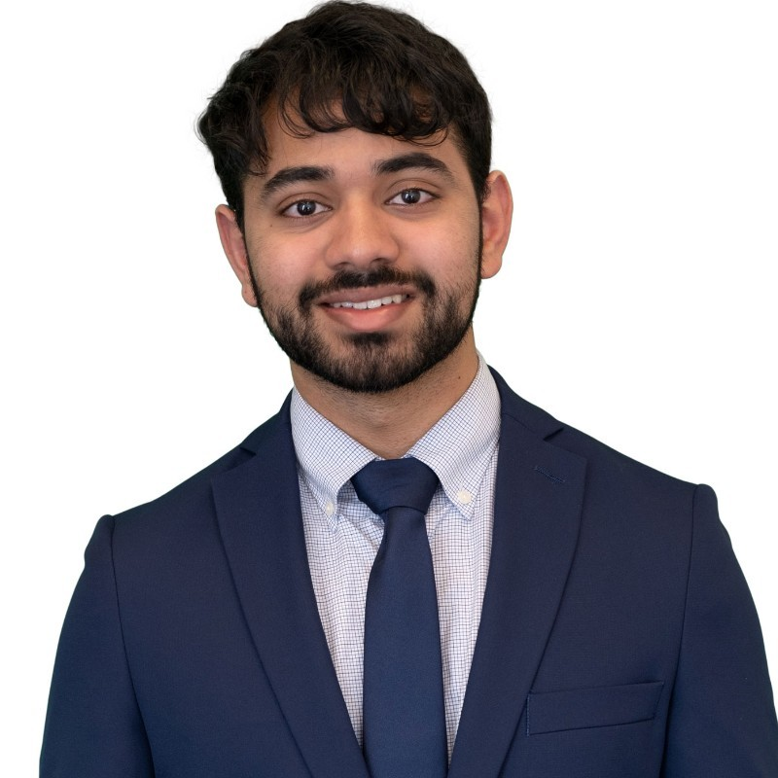
Team - DEVS
Arhab
Khan
Kobe
Wang
Maggie Zheng
Siddharth
Dudla
Siddharth
Khare
Balaji
Udayakumar

Slide 4
Results
Dataset and Data Wrangling
Given datasets consists of columns such as revenue, age_median etc.
Gathered new datasets, and took data from various sources and filled the missing values
Applied Random Forest ML model to find the most important features.
Predicted possible cities in USA according to the features using clustering.
Gathered additional data( land cost, avg wages per hour etc) to come to the final conclusion of selecting the two cities.

Slide 5
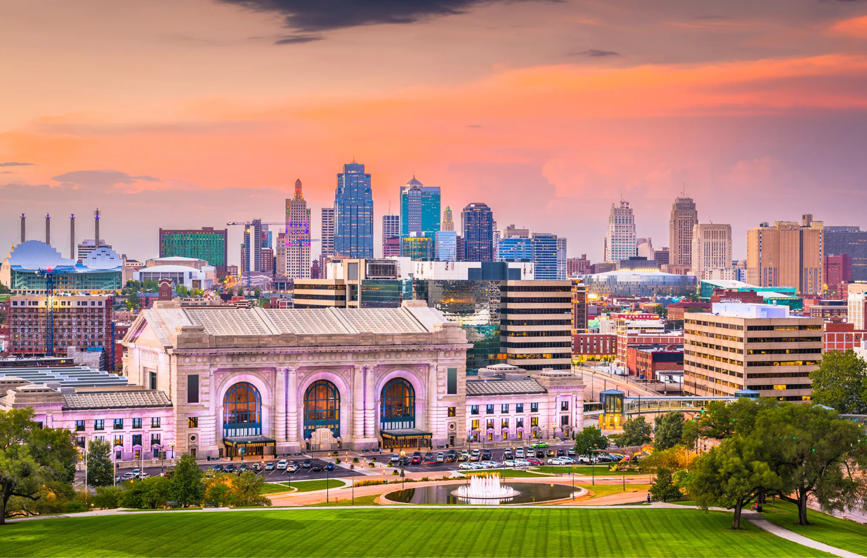
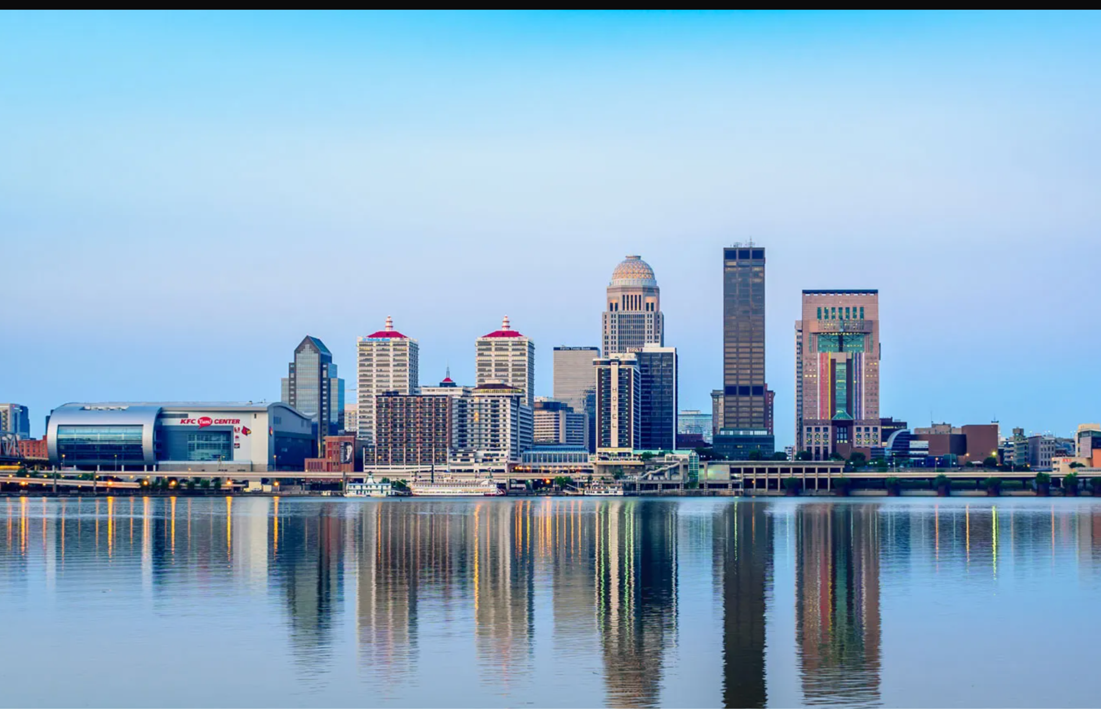
Results
Two Cities:
Kansas City, Missouri
Louisville, Kentucky

Slide 6
Advantages for both cities:
Kansas City | Louisville
Population: 509,297 T-Mobile Arena already built (18,000 seating capacity) Location is optimal for growth (Missouri) History of sports viewership Median education is higher | a. Land Cost is lesser b. Population is slightly more (624,444) c. Wages are slightly less ($24.76/hour)

Slide 7
Final Decision
Kansas City, Missouri presents a much better option because of the following reasons: a. T-Mobile Arena (Already Built) b. Location is optimal for growth c. History of Sports viewership d. Population and Salary go in hand and hand e. Median education is higher

Slide 8
Technical Analysis
Capital Expenditure
Cost (includes one-time and yearly costs): One-Time Costs: Infrastructure (Stadium): $1 Billion to $1.3 Billion (If an arena partnership deal is not reached with T-Mobile) Drafting Players: $141 Million Total One-Time Costs: $1.31 Billion Recurring: Operating Expenses : $39.28 Million/year Player cost: $127 Million/year Taxes: $13.6 Million/year Revenue Sharing: $10.9 Million/year Miscellaneous: $2.16 Million/year Total Recurring Costs (per year): $218 Million/year

Slide 9
Technical Analysis
Revenue Analysis
Revenue: Arena Sponsorship: $26.82 Million/year Premium Seating: $36.058 Million/year General Seating: $47.68 Million/year Broadcasting Rights: $150.4 Million/year Other: $35.19 Million/year Total yearly revenue: $298 Million/year

Slide 10
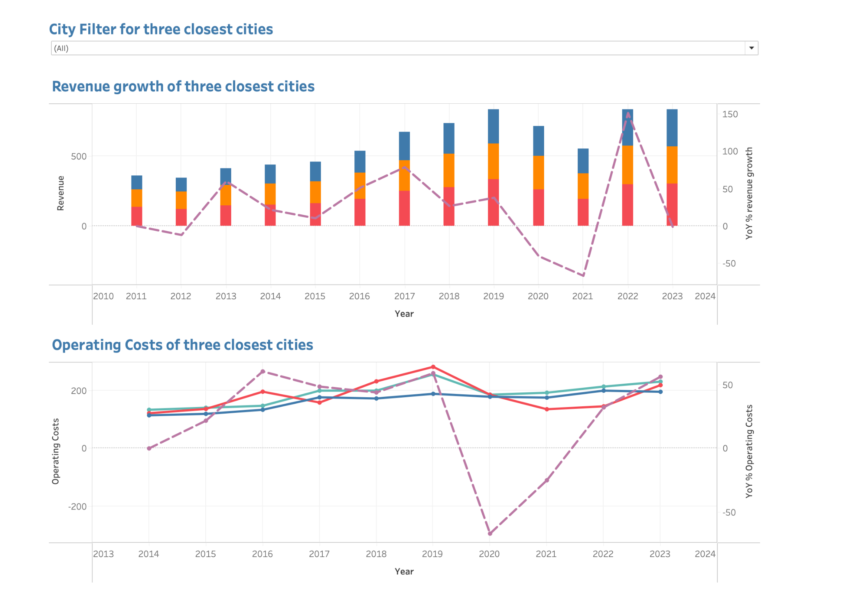
Results - Financial Analysis of 3 similar cities to Kansas City

Slide 11
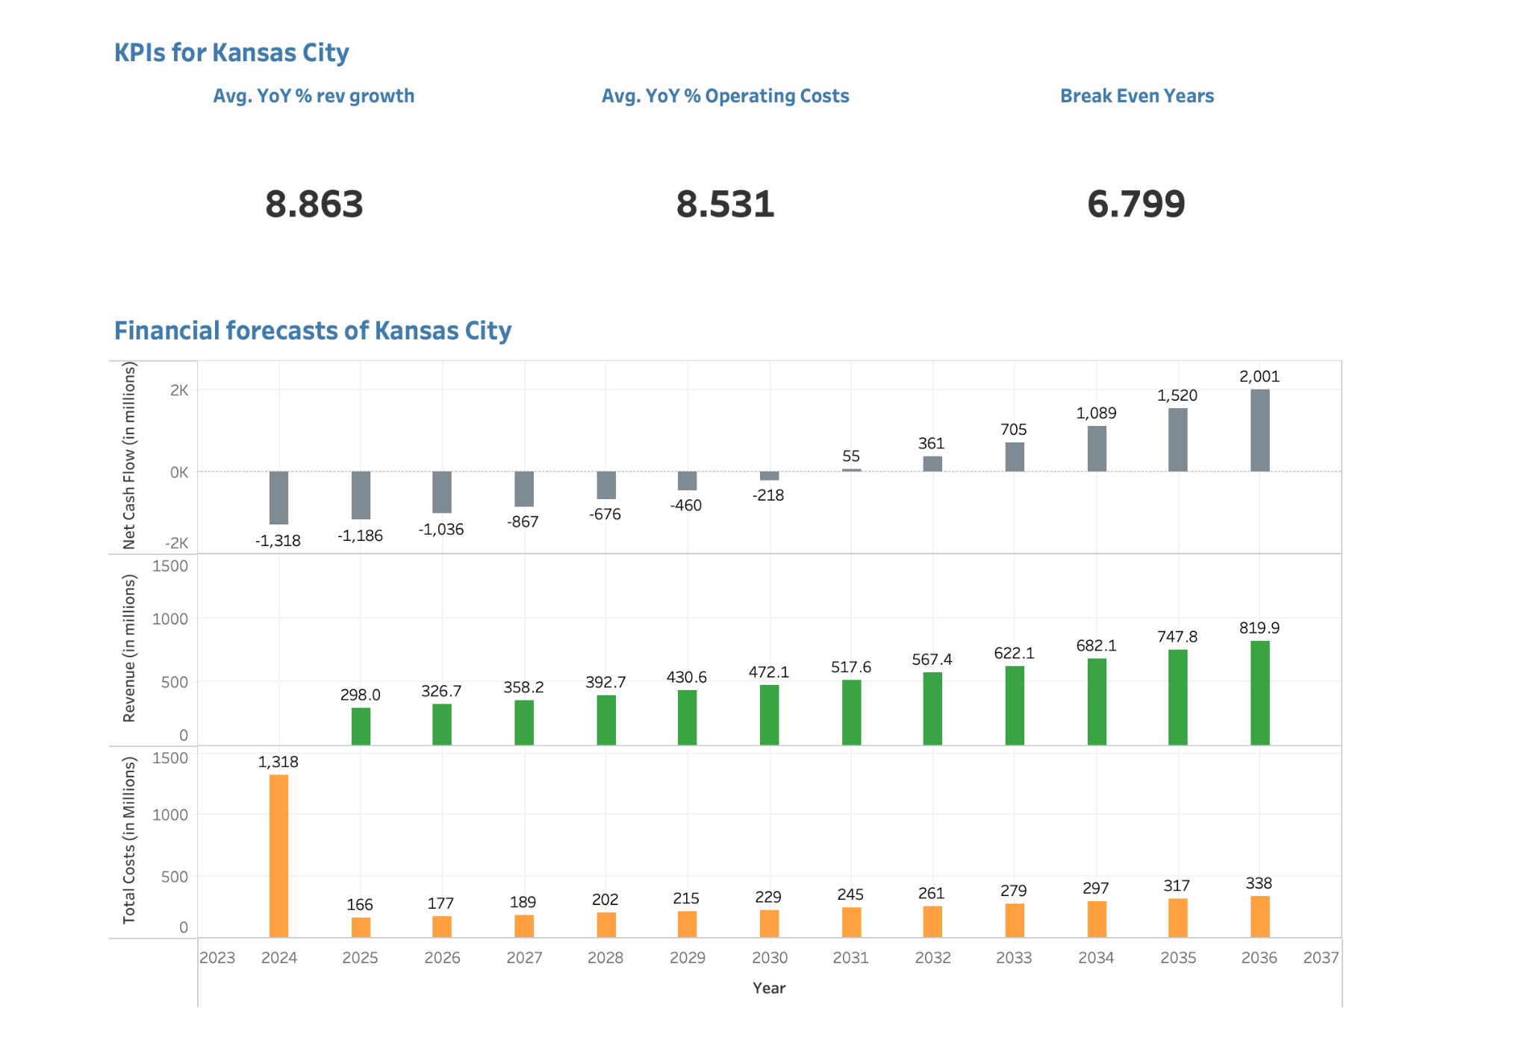
Cost Benefit Analysis - Kansas City

Slide 12
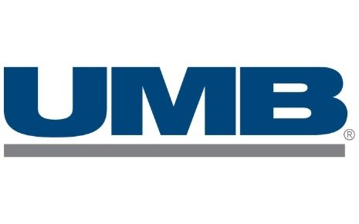
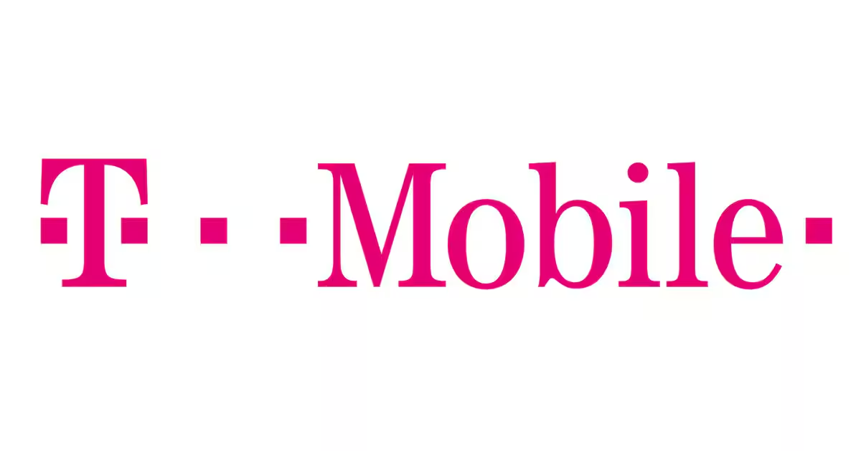
Technical Analysis
Sponsorship Analysis

Slide 13
Technical Analysis
Sponsorship Analysis
T-Mobile:
It is the third-largest wireless carrier in the United States with 117.9 million subscribers as of December 31, 2023.
The company has annual revenues of around $80 billion and can sponsor new NBA team easily.
T-Mobile Arena can host the NBA team in Kansas City
UMB Financial Corporation ( an alternate option):
It is a financial services company headquartered in Kansas City, Missouri.
Listed on NASDAQ
May be hard to get them on board as a large investment is required but can be considered as an alternate choice for sponsorship

Slide 14
Team Name and Mascot
What we think we should incorporate into our Maskot
Tornado: to pay homage to the city located in the Tornado Alley
Red: To symbolize Kansas barbeque traditions
Blue: Kansas City is known as the City of Fountains

Slide 15
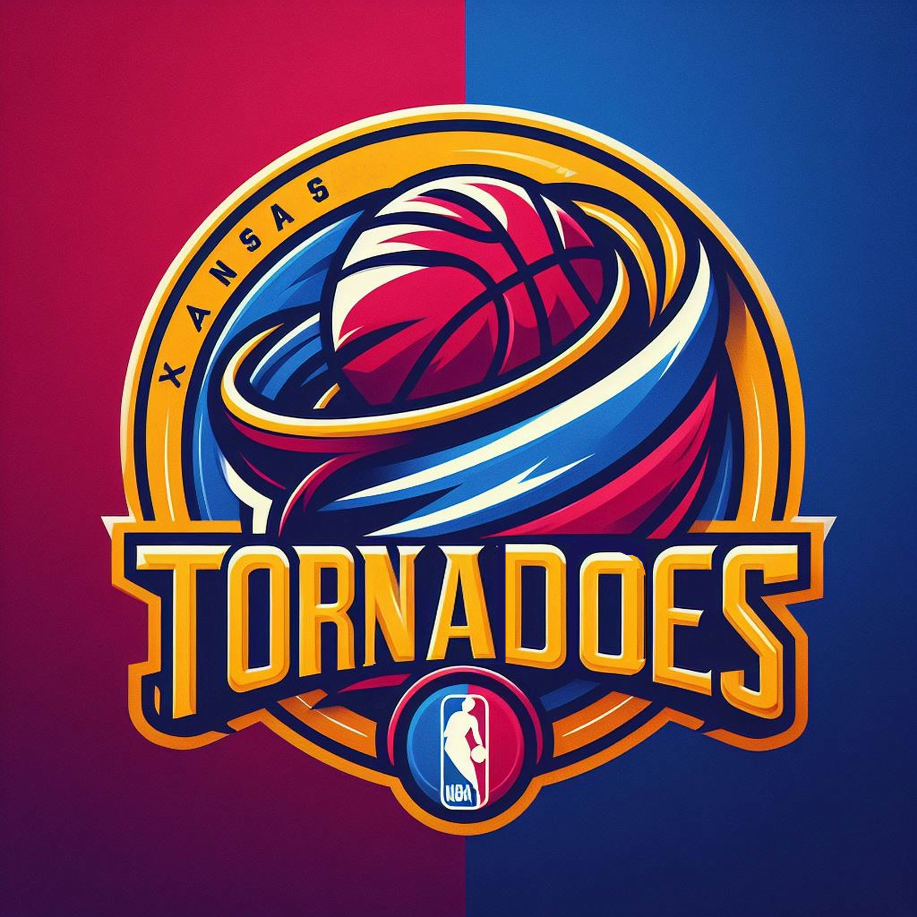

Slide 16
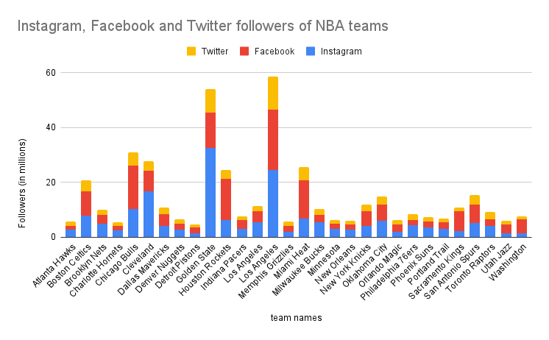
How might we promote this the Tornadoes?

Slide 17
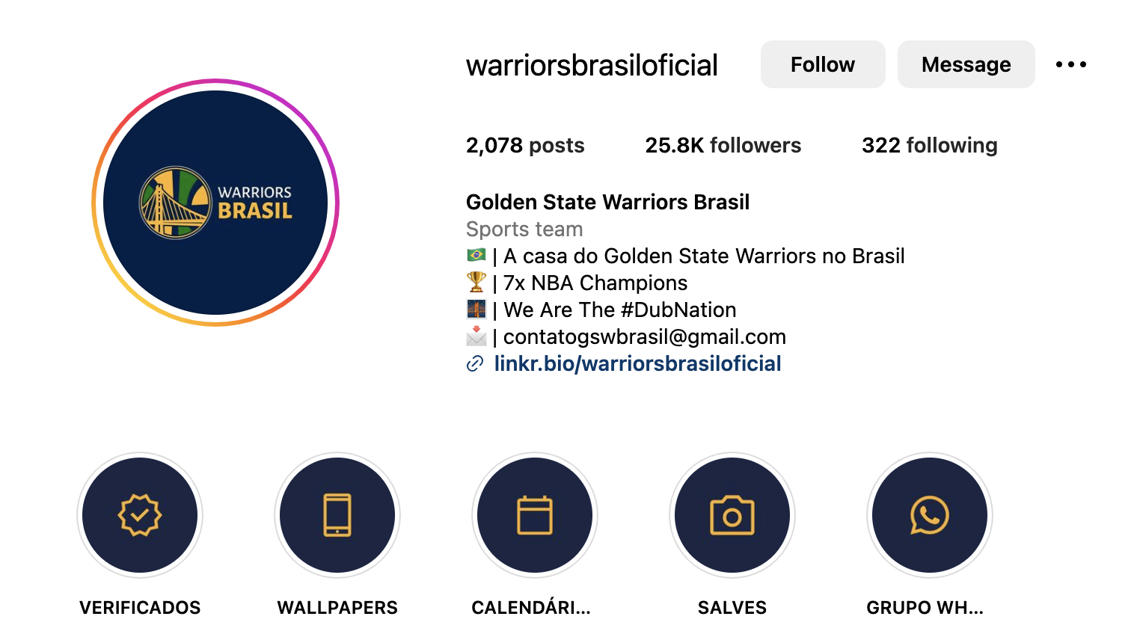
Tapping into the International Market

Slide 18


Tapping into the International Market Cont.

Slide 19
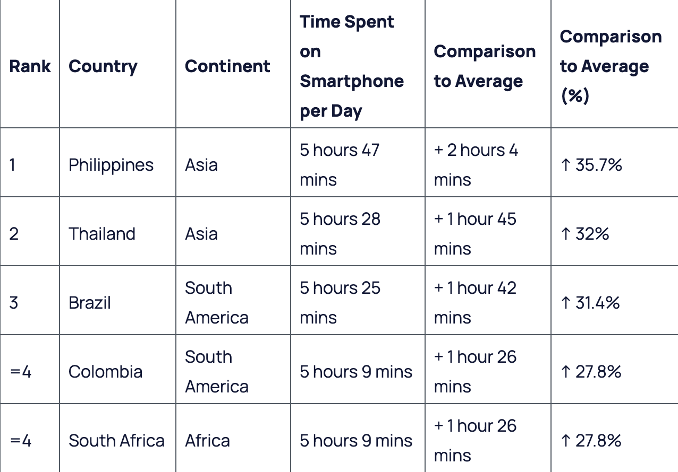
Tapping into the International Market Cont.

Slide 20

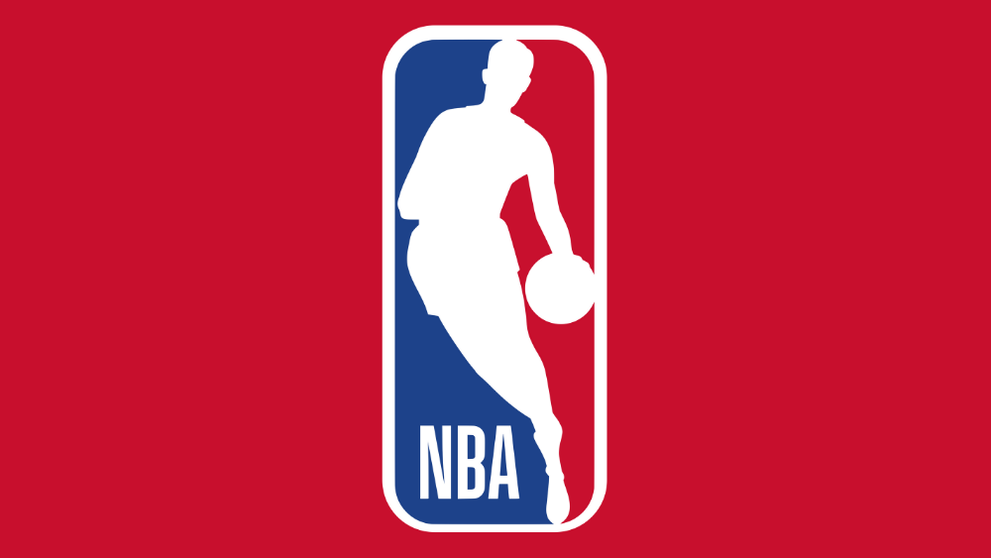
Tapping into the International Market Cont.
74.7%
8.4 Mil

Slide 21

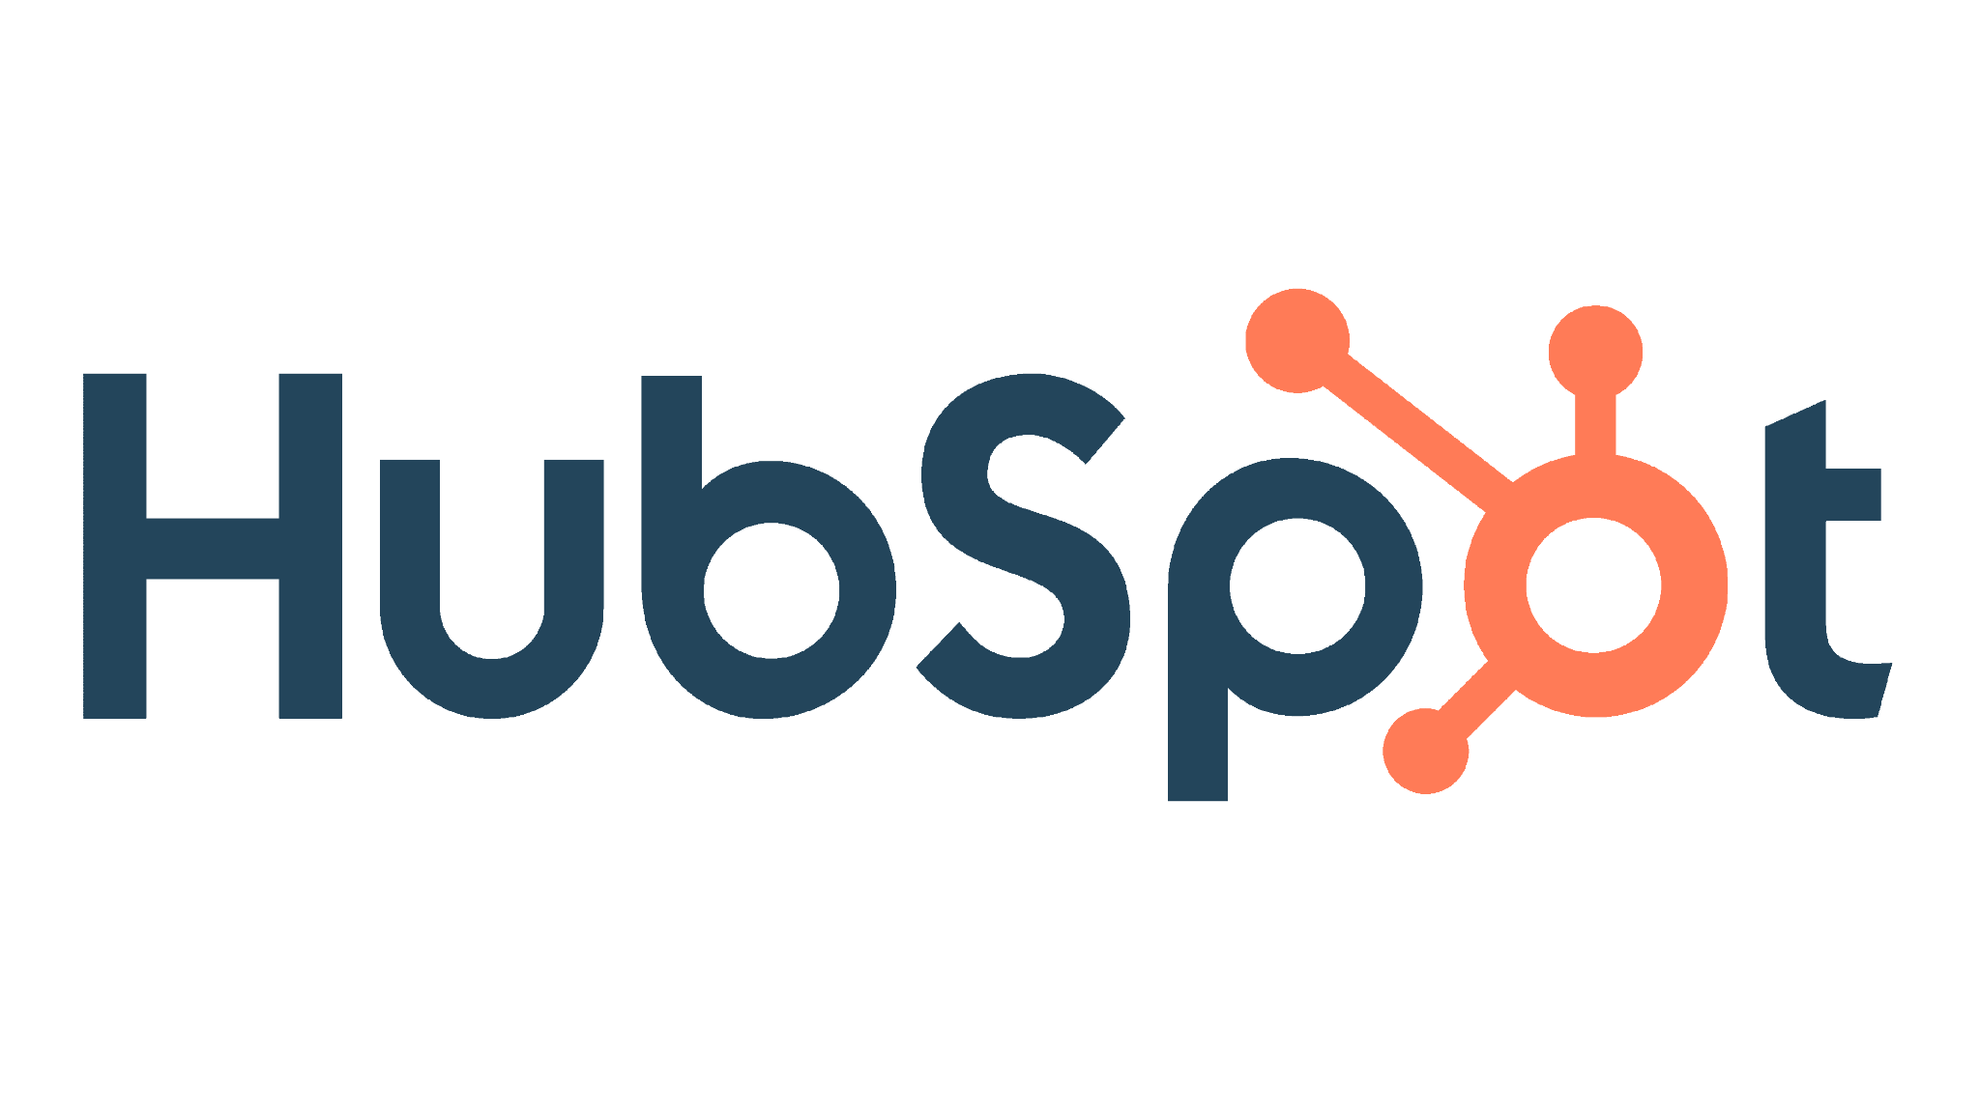


Marketing, Logisticals, and Management
Strategies for our new team “Kansas City Tornadoes” :
Community-driven Streetball Tournaments: Organize streetball tournaments across different neighborhoods in Kansas City, fostering a sense of community ownership and identifying local talent.
Interactive Museum Experience: Develop an interactive museum experience based on AR/VR technology within the arena showcasing the history of basketball in Kansas City, including the legacy of the Kansas City Monarchs.
Data-driven Fan Engagement: Utilize data analytics to personalize content and promotions for each fan, tailoring offers and experiences to their interests.
Notes:
Strategies for our new team “Kansas City Tornadoes” :
Community-driven Streetball Tournaments: Organize streetball tournaments across different neighborhoods in Kansas City, fostering a sense of community ownership and identifying local talent.
Interactive Museum Experience: Develop an interactive museum experience based on AR/VR technology within the arena showcasing the history of basketball in Kansas City, including the legacy of the Kansas City Monarchs.
Sustainability Initiatives: Partner with local sustainability organizations for "green games" with eco-friendly initiatives, appealing to environmentally conscious fans.
Data-driven Fan Engagement: Utilize data analytics to personalize content and promotions for each fan, tailoring offers and experiences to their interests.

Slide 22
Conclusions
References
https://data.census.gov
https://www.census.gov/data/developers/data-sets/acs-5year.html
https://www.forbes.com/lists/nba-valuations/?sh=77c82b9c6982
https://runrepeat.com/nba-revenue-statistics
https://www.forbes.com/sites/mikeozanian/2023/10/26/the-most-valuable-nba-teams-2023/
https://explodingtopics.com/blog/smartphone-usage-stats
https://playtoday.co/blog/stats/basketball-viewership-statistics/
https://napoleoncat.com/stats/facebook-users-in-philippines/2023/01/#:~:text=There%20were%2087%20400%20000,74.7%25%20of%20its%20entire%20population

Slide 23
Thank You! We’re open for questions.

